Slide 1


Polyglot Persistence and Big Data
Al.I. Cuza University of Iași
Faculty of Economics and Business Administration
Department of Accounting, Information Systems and Statistics
Document Databases. MongoDB
By Marin Fotache

Slide 2
Agenda
Introduction to MongoDB
Basics of Document Database Model: JSON
Getting Started with MongoDB
Install and launch MongoDB
MongoDB clients
Basic operations
Creating and updating collections
Insert documents: insert(), save()
Update documents: save(), update()
Updating scalar attributes
Updating arrays
Updating sub-documents

Slide 3
Agenda (cont.)
Basic queries in MongoDB
find() and findOne(), selection operators
Sorting, limiting and slicing results
Accesing arrays elements
Indexes
Cursors
Dealing with related collections
Aggregation Framework
Database modeling in MongoDB
Importing relational data in Mongo through R (changing the data structure)
Case study: sales

Slide 4
Starts with...
Free introductory course on MongoDB
https://www.udemy.com/introduction-to-the-mongodb/?couponCode=AGSGSDFREE24251

Slide 5
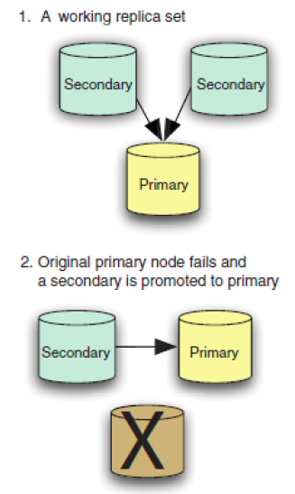
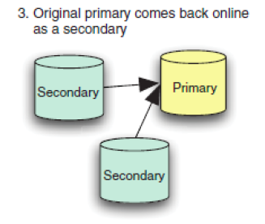
Simple Topology of MongoDB
Source: Banker, 2015

Slide 6
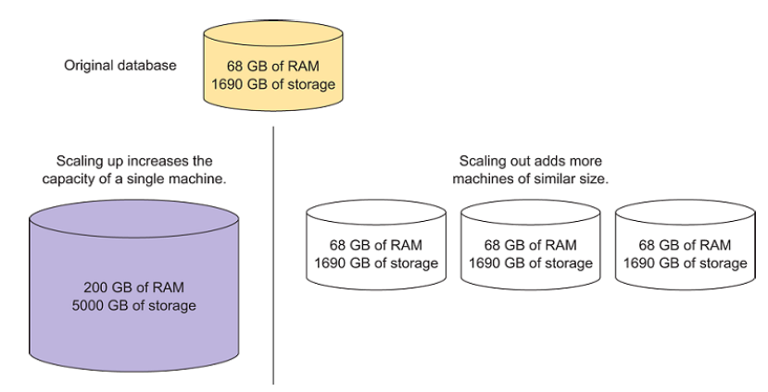
Vertical (left) vs. Horizontal Scaling
Source: Banker, 2015

Slide 7
Basics of Document Database Model: JSON
Basics of Document Database Model: JSON
Databases
Collections
Documents
Attributes/Fields:
Key-value pairs
ObjectId
Scalars
Arrays
Sub-documents

Slide 8
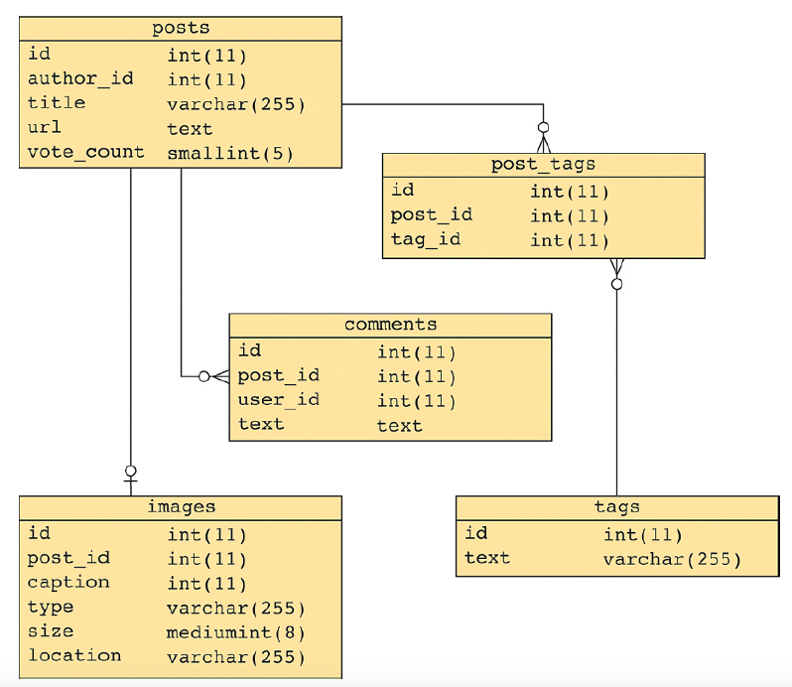
Entries on a Social News Site - relational
Source: Banker, 2015

Slide 9
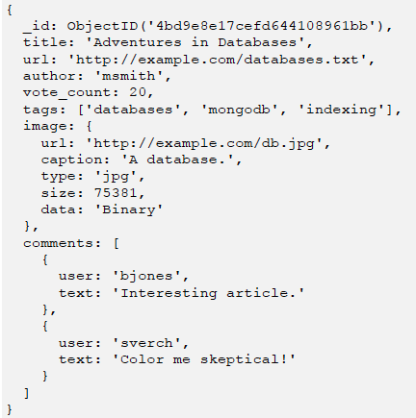
A Document Associated to an Entry on a Social News Site
Source:
Banker, 2015

Slide 10
Working with MongoDB
Basic client for MongoDB: MongoShell (Java Script)
http://docs.mongodb.org/manual/reference/mongo-shell
The best MongoDB client we have found (so far) is Robomongo/Robo 3T
https://robomongo.org
We will use (and recommend) this client (except for the scripts, since Robo3T cannot execute multiple commands at once)

Slide 11
Working with MongoDB (cont)
Topics covered in script 05-01_MongoDB – Introduction.js
Connect to MongoDB database
Some basic operations:
Getting help: db.help()
List databases: show dbs, show databases
Show current database: db
Display information/stistics about current database: db.stats()
Set the current DB: use
Display collections in current database: show collections
Display available commands: help()

Slide 12
Working with MongoDB (cont.)
Topics covered in script 05-01_MongoDB – Introduction.js (cont.)
Remove collections: drop()
Create collection:
createCollection()
insert(), insertOne(), insertMany()
save()
Display document(s) in collection:
findOne()
find()

Slide 13
Managing collections in MongoDB (Topics covered in script 05-02_MongoDB - Managing collections)
Basics of update(), save() and findAndModify()
Operators $set and $unset
Variables, functions and loops
Operator $inc
Managing arrays:
Operators $push and $each
Operator $addToSet

Slide 14
Managing collections in MongoDB (cont.) (Topics covered in script 05-02_MongoDB - Managing collections)
Managing arrays: (cont.)
Operator $pull
Operator arrayAttribute.index.property
Operator arrayAttribute.$.property
Updating sets of documents
"Upserts"

Slide 15
Basic queries in MongoDB (Topics covered in script 05-03_MongoDB - Queries (1), cursors)
Details about find() and findOne():
Selection
Projection
Limit
Skip
Basic operators for selection:
$ne, $not, $nin
$in
$or, $and
$gte, $gt, $lte, $le
$exists
null
$all

Slide 16
Basic queries in MongoDB (cont) (Topics covered in script 05-03_MongoDB - Queries (1), cursors)
Sorting results
Access/select array elements
$size
$slice
$elemMatch
Creating indexes
Declaring uniqueness
Indexes for speeding retrieval
Other commands useful in some basic queries:
count()
distinct()
group()

Slide 17
Cursors in MongoDB (Topics covered in script 05-03_MongoDB - Queries (1), cursors)
Basic information about cursors
Reading documents pointed by the cursor
hasNext()
forEach()
cursor.toArray()
Working with two or more (logically related) collections:
Without cursors
Using cursor

Slide 18
Aggregation Framework
The most important query tool in MongoDB
Introduced in version 2.2
Processes streams of documents through series of operators (pipeline)
Basic documentation: https://docs.mongodb.com/manual/aggregation/
Can be easily learned by comparing with SQL http://docs.mongodb.org/manual/reference/sql-aggregation-comparison/
See script: script 05-04_MongoDB - Queries (2) - Aggregation Framework

Slide 19
Presentations/Tutorials on Aggregation Framework
Very good series of video-tutorials on MongoDB Aggregation Framework
https://www.youtube.com/watch?v=A3jvoE0jGdE&list=PLWkguCWKqN9OwcbdYm4nUIXnA2IoXX0LI
The Aggregation Framework
http://www.mongodb.com/presentations/aggregation-framework-0
Aggregation Framework
http://www.mongodb.com/presentations/aggregation-framework-1

Slide 20
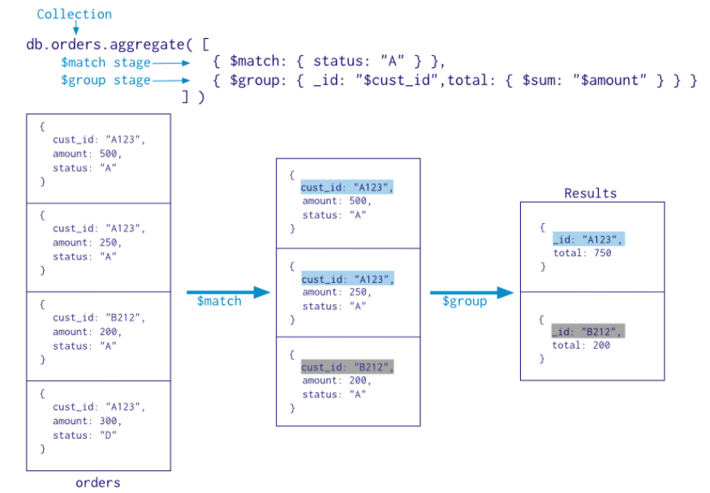
Basic schema of Aggregation Framework

Slide 21
SQL to Aggregation Mapping Chart

Slide 22
Database Modeling in MongoDB
O'Reilly Webcast: MongoDB Schema Design: How to Think Non-Relational (2014)
https://www.youtube.com/watch?v=PIWVFUtBV1Q
Schema Design Basics EMEA (2019)
https://www.mongodb.com/presentations/schema-design-basics-emea

Slide 23
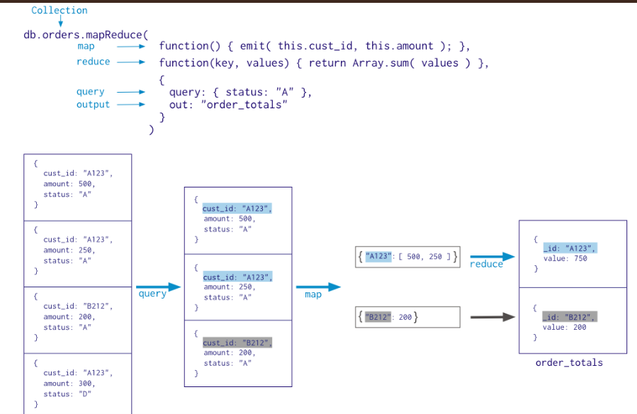
Map-Reduce in MongoDB

Slide 24
Case study: Sales
Database schema in MongoDB
One-collection version
Super-normalized (relational-like) version
Our solution:
Strengths
Weaknesses
The most important SQL queries "converted"into MongoDB Aggregation Framework queries
See script: 04-05_MongoDB - Case study – Sales.js

Slide 25
Recap: SQL vs MongoDB
SQL to MongoDB Mapping Chart
https://docs.mongodb.org/manual/reference/sql-comparison/

